Slide 1
Topic One
From management to leadership?
New perspectives and challenges
Dr Annelies Kamp
Dublin City University, Ireland

Slide 2
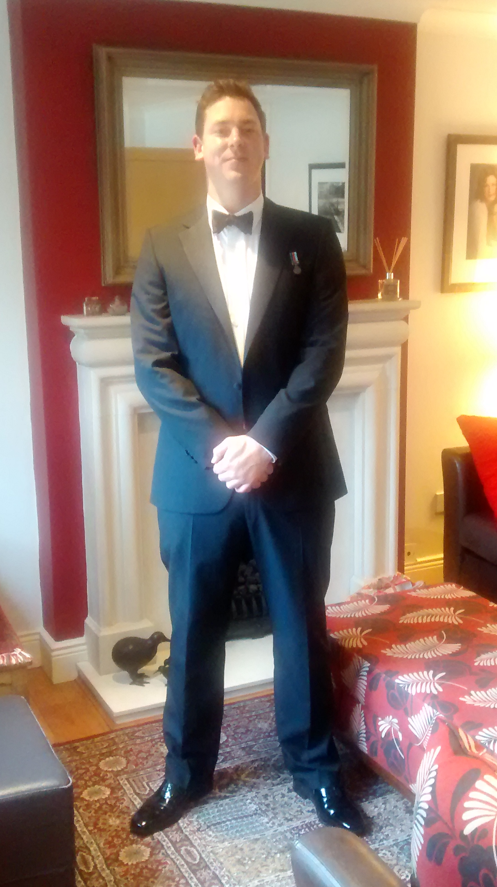
Who am I?

Slide 3
How will we journey?
Why metaphor when thinking of leadership and management?
Two dominant metaphors
Leaders and/or managers
Paradigmatic misalignments, new perspectives and challenges

Slide 4
Three concepts for understanding the nature and organization of social science. Morgan, G 1980. p.606
Paradigms, that is, alternative realities
Metaphors based on schools of thought
Puzzle-solving activities based on specific tools and texts

Slide 5
Leaders need to . . .
Firstly, become aware of the metaphors they habitually use.
Secondly, feel confident in working with metaphors other than those they habitually use.
Thirdly, recognize their active role in shaping organizations as they read them.
Finally, accept that the 21st Century demands new organizational forms and competencies.

Slide 6
Notes:
.

Slide 7
The words ‘leadership’ and ‘management’ both appeared at about the same time in the nineteenth century as descriptions of what business leaders and managers, as well as politicians, actually did, namely, the politics of guiding and influencing the options and actions of others using persuasion and domination. The words described rather different activities, one elevated and the other rather lowly.
Stacey R. 2012 (p.3)
Notes:
As such, my position here is to work with the idea that leadership and management are not mutually exclusive: they are both present however the dominance of either the elevated or lowly activities has shifted across the decades. It is this shift that this lecture will explore.

Slide 8
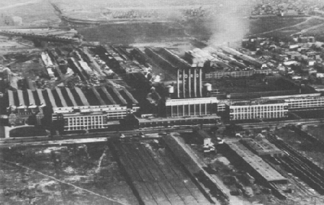
Source: www.vanderbilt.edu (accessed 16.02.2011)

Slide 9
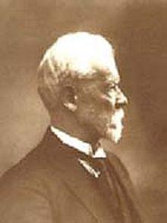
Fayolism
Division of work.
Authority.
Discipline.
Unity of command.
Unity of direction.
Subordination to general interests.
Remuneration.
Centralization.
Scalar chain.
Order.
Equity.
Stability of tenure.
Initiative.
Esprit de corps.
Henri Fayol
Source: Wikipedia (accessed 30.09.11)
Notes:
Categorized as five or six functions: (1) planning; (2) organizing; (3) leading; (4) controlling (5) forecasting.

Slide 10
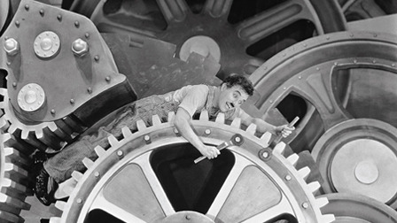
Taylorism
Shift all responsibility for the organization of work away from the worker to the manager.
Make decisions about the design of work based on precise, objective measurements rather than ‘rule of thumb’.
Use methods to select and train the person to fit this precise work task.
Monitor performance to make sure all specified procedures are followed
Image source: http://www.criterion.com/films/27526-modern-timess
Notes:
Source: http://www.criterion.com/films/27526-modern-times
Classical management theory that privileged structure and technology over people and emotion remains a leading management metaphor. Throughout the 20th century its favour has ebbed and flowed with academics yet it has retained its appeal to managers given the appearance of control it provides. However as Morgan notes, the highly bureaucratized organizational form can struggle to meet the challenges we face in a complex globalised world.

Slide 11
The limits of instrumental rationality
The world is full of unpredictability
Rules are less clear-cut than their presentation
They need to be ‘particularized’
Experts do not rely on rules: rules can destroy proficiency and expertise
Instrumentally rational tools and techniques cannot cope with the unpredictable, unique situations which require intuition, accidents, ambiguity …
Stacey (2012)

Slide 12
School leadership as machine
Lumby & English (2010: 24)

Slide 13
Source: http://www.dreamstime.com/stock-images-bumblebee-rimagefree2597060-resi3877577
Notes:
http://www.dreamstime.com/stock-images-bumblebee-rimagefree2597060-resi3877577

Slide 14
A post-industrial environment
Ideological
Social
Economic
Technological
Organizational
Employment
Lifestyle
Wicked problems …
Aviram 2010
http://www.dreamstime.com/free-stock-photo-money-rimagefree1182365-resi3877577
Notes:
These changes from industrial to the post-industrial society have had an impact an our education and training structures.
However, many commentators would argue that schools and other sites of learning have remained glued to the industrial mindset and the machinic metaphors that help us think about them

Slide 15
New Public Management (NPM)
Ideological shift towards individualism
Increasing use of private sector management tools and techniques
Metrics-based performance measurement
Steering from a distance…
Notes:
Move from traditional public administration of the Taylorist kind to NPM of the organic kind.

Slide 16
Performativity is a technology, a culture and a mode of regulation … that employs judgements, comparisons and displays as means of control, attrition and change. The performances (of individual subjects or organisations) serve as measures of productivity or output or displays of ‘quality’. (Ball 2000:1)

Slide 17
The leader/manager contradiction
A policy context that
sees ‘wicked’ problems
and collaborative solutions
Yet is
governed by performativity
as a meta-discourse
The leader must also be a strong manager …

Slide 18
Managers and leaders are different
For Zalenik (1977), the manager/leader cannot be one person.
The difference between these people lies in their conceptions of chaos and order. Managers and leaders are
motivated differently
have different histories
have different action logics
Professor Abraham Zaleznik
Source: Harvard Business School

Slide 19
Managers
Embrace rationality, goals and targets
They move swiftly to correct disorder, limiting the range of action options that might be chosen
Leaders
Embrace innovation
They have a high capacity to tolerate chaos so can bide their time in choosing or creating a course of action

Slide 20
Managers
Adopt a passive, impersonal goal orientation. They ‘prefer to work with people; they avoid solitary activity because it makes them anxious’.
Leaders
Adopt a personal, active goal orientation that creates the world they work within.

Slide 21
‘What it takes to ensure a supply of people who will assume practical responsibility may inhibit the development of great leaders. On the other hand, the presence of great leaders may undermine the development of managers who typically become very anxious in the relative disorder that leaders seem to generate’.
Zaleznik (1977:75)

Slide 22
However …
Even if it were this clear cut, and even if we value leadership as a response to the challenges of the post-industrial environment, research suggest leaders are frequently bogged down in management; and that managers frequently lead.
We should be seeing
managers as leaders,
and leadership as
management well practiced.
Mintzberg 2009: 9

Slide 23
Leadership and management are not identical and need to be disentangled, but there is a complementarity between them.
OECD 2013
By putting leadership on a pedestal separated from management we turn a social process into a personal one. No matter how much lip service is paid to the leader empowering the group, leadership still focuses on the individual: whenever we promote leaders we demote others as followers. Slighted too is the sense of community that is important for cooperative efforts in all organizations.
Mintzberg 2009:9

Slide 24
Leadership as management well practiced
Source: http://prebenormen.com/leadership-2/management-leadership-2/the-good-bad-and-ugly-of-managing-styles

Slide 25
Mintzberg (2009:129)

Slide 26
7 Ways of Leading
Action Logic | Characteristics | Strengths | Percent
Opportunist | Wins any way possible | Good in emergencies | 5%
Diplomat | Avoids overt conflict | Brings people together | 12%
Expert | Seeks rational efficiency | Good individual contributor | 38%
Achiever | Meets strategic goals | Action and goal oriented | 30%
Individualist | Interweaves personal and company logics | Effective at venture work | 10%
Strategist | Creates transformations | Transformational leader | 4%
Alchemist | Generates social transformation | Good at macro transformation | 1%
Notes:
Rooke & Torbert 2005 – what differentiates leaders is not their philosophy of leadership or their personality – it is their action logic. 25 years of research with thousands of managers 25-35 years.

Slide 27
Persisting challenges
The OECD (2013:22) suggest that the roles of leadership and management are complementary and that this recognition calls for an ‘imposing range of expectations and approaches for the same leaders to do both well’.

Slide 28
The dilemma …
ROCK | T | WHIRLPOOL
Consistency | E | Choice
Reliability | N | Diversity
Performance | S | Dynamism
Transparency | I | Spontaneity
Competition | 0 | Autonomy
 | N

Slide 29
Different logics
Management theory remains focused on the principles of scientific management:
Control
Order
Predictability
Linear relations of cause and effect
But imagine a whirlpool in a river. While possessing relatively constant form, it has no existence other than in the movement of the river.
Source: http://www.dreamstime.com/water-imagefree493

Slide 30
Characteristics of complex systems
Three key characteristics of complex systems:
SELF ORGANIZATION, COMPLEXITY, EMERGENCE
Complex systems can create behavior that is neither definitively predictable nor unpredictable
They adapt in the face of change initiating micro-events
The whole is more than the sum of the parts
Dynamic networks of interactions: the whole is not an aggregation of ‘static’ pieces
They stimulate outputs that cannot necessarily be predicted simply by understanding all of the inputs.
Marion and Bacon (2000)

Slide 31
Ordered system management
Complex system management
The system and the agents within it co-evolve
The system constrains behaviour of the agents
And the agents modify the system in their interaction with it
All agent behaviour is/should be fixed by the rules of the system
The system is ascendant
Notes:
We want to explore what these logics might tells us about the relationship between management and leadership.

Slide 32
Autopoiesis (Maturana & Varela, 1980)
Autopoiesis — based in the biological sciences — suggests all living systems are, in fact, closed and subordinate all changes to the maintenance of their own organization as a given set of relations
There is an environment but relations with it are internally determined in ways that are always self-referential.

Slide 33
The brain creates images of reality that align with its own pattern of relations and continually modifies them based on experience
The unwell brain creates images of the same reality that align with its own pattern of relations and continually modifies them based on experience

Slide 34
Autopoiesis
Three implications:
Organizations are continually enacting their environments in seeking a ‘sustaining’ closure
Problems with ‘the environment’ can be problems about the identity that is being maintained
Attempts at organizational change must give attention to the patterns shaping the whole ‘organization-environment system’
To understand and survive with your environment you must
understand yourself and the system constraints
be able, if necessary, to redefine the boundaries of your organization
Notes:
In order to be recognized as such, a system must be bounded in some way. Specifying the boundary is not as simple as we might think.
Boundaries are a function of the system AND a product of the ‘strategy of description’ that is used. (Cilliers, 2001)

Slide 35
Cybernetics
Cybernetics is the study of systems and processes that interact with themselves and produce themselves from themselves
Complexity is inherent in dynamic systems because their processes are often non-linear, hard to observe and hard to control.
The only way to deal with complexity is to acknowledge its presence.
This means understanding the regulation and communication processes within the system: cybernetics

Slide 36
Cybernetics
Cybernetics focuses on self-regulating behaviours:
Positive feedback: more leads to more, and less leads to less
Negative feedback: more leads to less, and less leads to more
Its focus is how anything processes information, reacts to information, and changes or can be changed to work more efficiently or effectively.

Slide 37
Complex situations can only be dealt with with at least the same amount of complexity
The richness of analysing situations as loops instead of lines … But it is also overwhelming
Tactics:
Search for key system patterns — system ‘archetypes’ (Senge, 1990)
Identify points of delay in feedback loops
Explore the loops between sub-systems
Identify blocks to desired loops
Think about the most generative point to intervene
Explore archetypes that may escalate to problematic states

Slide 38
Manager and leaders use processes that draw on these principles every day at amplify or de-amplify a given ‘attractor’ pattern
An attractor is …
In their communication and reporting systems
In their feedback to staff
In their performance management of staff
In the focus of newsletters and other internal and external media
In monitoring the pulse of the environment they are part of …

Slide 39
Chaos theory
Derived from research into weather systems
Even a small, apparently insignificant, amount of turbulence, can lead to radical unpredictable consequences but does not cause them
HOWEVER, a pattern holds: we do not get snow in the Sahara
Lorenz 1979, 1993

Slide 40
Think of the organization and its environment as part of one evolving pattern:
Organizations as complex systems are both ordered and chaotic
A range of ‘attractors’ exert influence
Random events can produce unpredictable relationships that create novel patterns of change
If a system has some degree of complexity, these novel patterns are a resource for change
New order always emerges out of randomness and surface chaos
Aim to move from unpredictable to repeatable

Slide 41
Complexity in management and leadership
1) complex systems are at risk when at equilibrium. Although it may be counter-intuitive, equilibrium and stability are precursors to failure.
2) complex systems exhibit the capacity to self-organize and show emergent properties, and therefore the edge of chaos is not actually chaotic

Slide 42
Complexity in management and leadership
3) complex systems move toward the edge of chaos when confronted with a complex task
4) complex systems are living systems that are over-determined and cannot be directed, only disturbed.
Pascale,1999
Notes:
Over-determined meaning that they are influenced by multiple causes.

Slide 43
So leadership means …
Rethink the nature of order and organization
New order emerges in any complex system pushed to an ‘edge of chaos’ situation
Complex systems have some form of order, but it isn’t fixed
Hierarchy is an outcome, can be flat, can be driven from anywhere in the organization.
Cilliers 2001

Slide 44
2) Leading a context
The role of the manager is to shape a context where self-organization can occur and
where desirable attractors are dominant
Identify the level of specification — the ‘minimum specifications’
Work on new understandings and new actions
Experimentation
Double loop learning

Slide 45
3) Use the butterfly effect
Be attentive to high-leverage opportunities, often found in paradox
Identify emerging paradoxes
Create your own
Understand that incremental change and quantum change can be the same thing

Slide 46
Organizational paradoxes
Morgan (2006:282)
Innovate |  | Avoid mistakes
Think long term |  | Results now
Cut costs |  | Increase morale
Reduce staff |  | Improve teamwork
Be flexible |  | Respect the rules
Collaborate |  | Compete
Decentralize |  | Retain control
Specialize |  | Be opportunistic
Low costs |  | High quality

Slide 47
4) Accept emergence as a natural state of affairs
Be mindful of the principles of holographic self-organization
Adopting a fractal quality where separate organizational units are formed: embedded in environment yet linked through culture, technology and

Slide 48
Humans have independent minds of their own and will be stimulated and inspired to create and innovate at unexpected times. The reason complexity thinking is helpful is that it assists managers to bypass old tendencies to try to control all activity in a cause and effect way.
Smith & Humphries, (2004:103)

Slide 49
Paradigms, metaphors, and related schools of organizational analysis. Morgan, G 1980. p.608
Sociology of Radical Change
Radical humanist paradigm
Radical structuralist paradigm
Subjective
Objective
Interpretive paradigm
Functionalist paradigm
MACHINE & ORGANIC METAPHOR
Sociology of Regulation
ES502 Introduction to Management Thought 2011/2012

Slide 50
Questions for discussion
If managers and leaders are simply different kinds of people, what implications does this have for the design of leadership programmes?
If, when we privilege leadership, we demote others as ‘mere followers’ what implications does this have for education and training providers who might best flourish as communities of actors?
What new metaphors could guide our thinking about leadership in complex times? Should we move beyond the functionalist paradigm ?

Slide 51
References
Aviram, A. 2010. Navigating through the storm. Reinventing education for post-modern democracies. Rotterdam: Sense.
Ball, S. 2000. Performativities and fabrications in the education economy. Australian Educational Researcher. 27, 2, 1-23.
Cilliers, P. 2001. Boundaries, hierarchies and networks in complex systems. International Journal of Innovation Management, 5,2,135-47
Lorenz, E. 1979. Predictability: does the flap of a butterfly’s wing in Brazil set off a tornado in Texas? Address at the American Association for the advancement of Science, Washington
Lumby, J. & English, F.W. 2010. Leadership as lunacy. And other metaphors of educational leadership. Thousand Oaks. Corwin.
Marion, R & Bacon, J. 2000. Organizational extinction and complex systems. Emergence, 1,4, 71-96
Mintzberg, H. 2009. Managing. San Francisco: Berrett Koehler.
Morgan, G. 2007. Images of organization. Thousand Oaks. Sage.
Morgan, G. 1980. Paradigms, metaphors and puzzle solving in organizational theory. Administrative Science Quarterly, 25, 605-22.
OECD 2013. Leadership for 21st century learning. Paris: OECD.
Pascale, R. 1999. Surfing the edge of chaos. Sloan Management Review, Spring, 83-94
Senge, P. 1990.The Fifth Discipline: The art and practice of the learning organization. New York: Doubleday.
Smith, A. & Humphries, C. 2004. Complexity theory as a practical management tool. A critical evaluation. Organization Management Journal, 11.2. 91-106
Stacey, R. 2012. Tools and techniques of leadership and management. Meeting the challenge of complexity. Abingdon. Routledge.
Styhre, A. 2007. The innovative bureaucracy. Bureaucracy in an age of fluidity. Abingdon: Routledge.
Zalzenik

