Slide 1
Leadership and learning Possibilities and limitations Education policy as a one of the public policies
Anna Kolomycew
Department of Political Science
University of Rzeszow
Poland

Slide 2
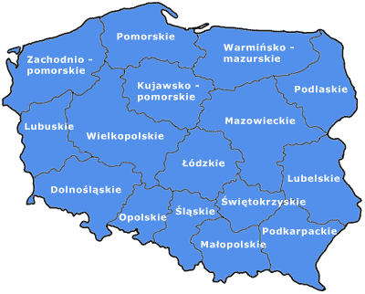
Podkarpackie region
http://www.polishbusiness.biz/regiony.html

Slide 3
http://fotopolska.eu/270580,foto.html
http://www.polska.travel/pl/w-gorach/bieszczady/

Slide 4
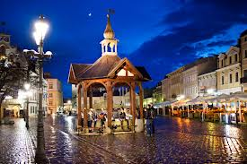
Rzeszów
http://www.biznesistyl.pl/aneta-gieron/142_ten-nasz-rzeszow.html
http://www.rzeszow4u.pl/aktualnosci/rzeszow-zdobywa-nagrody.html

Slide 5
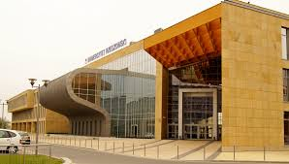
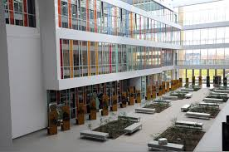
University of Rzeszow
since 2001;
10 faculties
40 departments
over 22,000 full- and part-time students
staff about 2,000 people

Slide 6
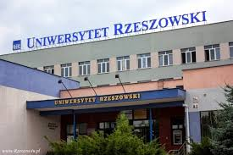
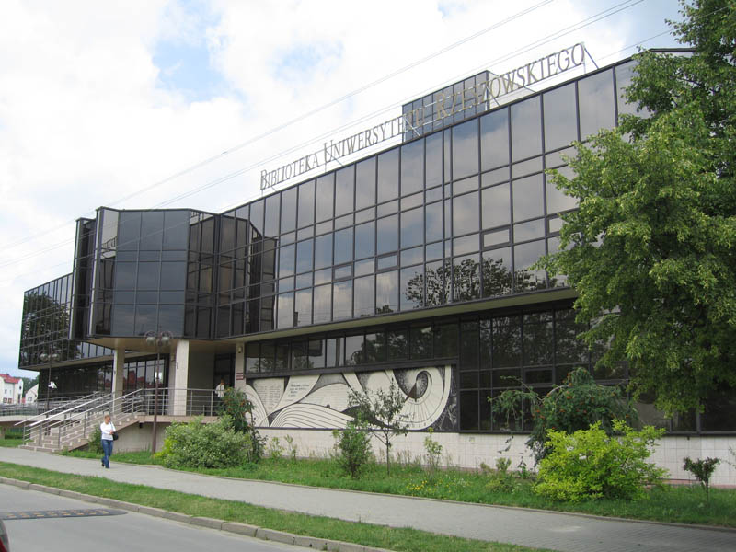
More:
University of Rzeszow
http://www.ur.edu.pl/en
UR film:
http://www.youtube.com/watch?v=UUWnVR0LVE4

Slide 7
Faculty of Sociology and History
incorporates the following Institutes:
Institute of Archaeology
Institute of History
Institute of Philosophy
Institute of Sociology
Department of Political Science
Programmes/courses:
BA programmes;
MA programmes;
PhD programmes in archaeology, history and sociology;

Slide 8
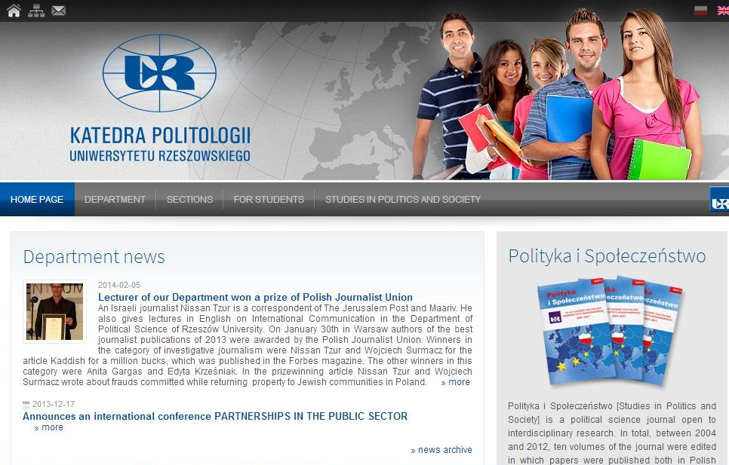
Department of Political Science
http://www.politologia.univ.rzeszow.pl/en

Slide 9
Structure of the Department of Political Science
Section of Public Administration and Public Policy
Section of Social Communication
Section of International Political and Economic Relations
Section of Theory of the State, Law and Politics

Slide 10
Scientific Journal:
„Studies in Politics and Society” (ISSN 1732-9639)
Editorial Office – contact:
Political Scien Department Al. Kopisto 2a, 35-015 Rzeszów
phone.: +48 17 872 20 53
e-mail: polispol@univ.rzeszow.pl
Guidelines for contributors:
http://www.politologia.univ.rzeszow.pl/en

Slide 11
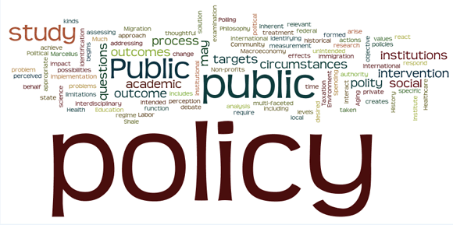
Public policy – public services:
Public policy can be understand as:
Identification of social problems;
Study of the political processes;
System of services delivery;
How individuals and institutions respond to the implementation of policies;
Functioning of public institutions;
Chanegs in polices implementation;
Source: Bucknell University, https://www.bucknell.edu/centers-institutes-and-resources/institute-for-public-policy/what-is-public-policy.html

Slide 12
Types and levels of policy policies:
macro level
sector/issue-oriented policy
micro level

Slide 13
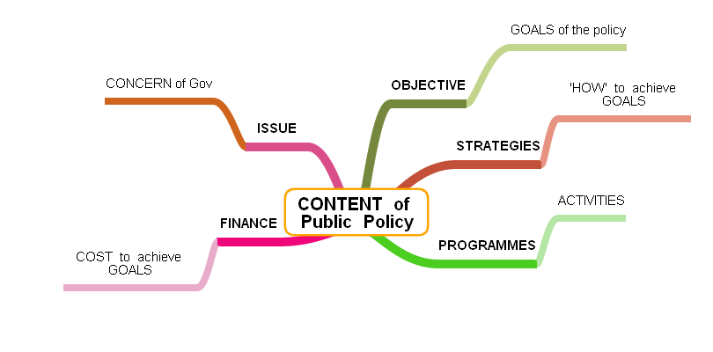
Source: http://adminscience.blogspot.gr/2012/03/public-policy.html

Slide 14
Source: https://www.e-education.psu.edu/eme803/node/516

Slide 15
Key atributes of public policy:
made to solve some issues or problems;
formalized (form of law, regulation, provisions, strategis, programmes, projects);
made on behalf of the "public”;
goals and solutions-oriented;
made by goverment (public authorities) – ideas might come from outside;
policymaking is onging process - continually reassessed, revisited and revised;
Source: Project Citizen, http://new.civiced.org/pc-program/instructional-component/public-policy

Slide 16
Public services:
offered to the general public and/or in the public interest;
broad access (available for everyone);
the societal value;
should not be monopolised by individuals;
should be delivered effectively and efficiently;
respond to the new expectations of the society;
provided by wide range of actors (not only public sector);
connectivity of citizens, businesses, social sector, local and regional actors and individuals is needed to implement them;

Slide 17
Evolution of management model in
public service delivery
Traditional administration
New Public Management
Good Governance

Slide 18
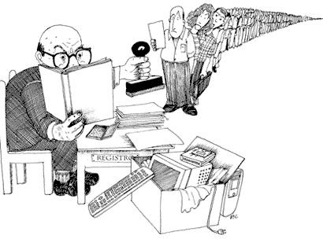
Traditional model of administration (Max Weber)
developed in Germany and spread during the industrial revolution;
crucial to the development of large scale enterprises, private or public, throughout the developed world;
Source: http://www.redakcja.agror.pl/?attachment_id=62

Slide 19
Model of (ideal) bureaucracy
Source: http://rgandersen.wordpress.com/managing-organization-design-2/

Slide 20
Characteristic of the traditional model:
top to bottom orientation - hierarchy;
expanded and complex system of control;
policy and decisons are set at the top (center);
expanded reporting system (to the superior);
based on a set of rules/provisions of public law;
rationality and legality - guarantee the stability of the system;
presense of political influences (political superiors);
moral discipline and self-denial;

Slide 21
You are absolutely right, but I am the one who holds the stamp….
Source: http://blogacisza.pl/?p=772

Slide 22
Traditional model characteristic by G. Peters:
1) Apolitical civil service;
2) Hierarchy and rules;
3) Permanence and stability;
4) An institutional civil service;
5) Internal regulation;
6) Equality (internally and externally to the organization)

Slide 23
Is traditional model of organization inefficient?
some organizations – generally large – work better based on the traditional model
the alternative for traditional model is/might be market

Slide 24
2) New Public Management
early beginnings NPM - the USA (1930s) - the Industrial Revolution - it changed the way business was done; benchmarked by the public sector;
the origin of NPM at the end of the 1970s or the middle of the 1980s;
the UK, New Zealand, the US - strong tradition of the capitalist concepts;
http://www.esade.edu/public/modules.php?name=news&idnew=659&idissue=&newlang=catala&newlang=english

Slide 25
Background for NPM implementation (S. Tolofari):
economic factors:
experience of economic and fiscal crises;
looking for efficiency and new ways to cut the cost of public services delivery;

Slide 26
political factors:
rejuvenation of the political Right – the New Right (Reagan 1978; Thatcher 1979);
the idea and reforms continued by Labour government (the UK) and Democratic government (the US);
general ideological shift to the Right, which meant:
a) smaller public sector;
b) public sector based on market mechanisms;
c) top-down implementation of the reforms;

Slide 27
social factors:
relationships between the people and their governments (re-established);
the enthusiasm for and implementation of NPM differ in different countries;
involvement of the citizens in the processes of policy creation and implementation;
greater social activisim and interest in public sphere;

Slide 28
Intellectual factors:
need for intellectual input, techniques, guiding principles;
influence of public administration theorists and practitioner;
Technological factors:
distribution of information and ICT development;
spread of the philosophy and processes of NPM (and convergence);
technology helps to coordinate actions among loosely connected networks or devolved, decentralized entities and different actors;

Slide 29
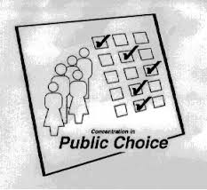
Theories related to the NPM:
Public Choice Theory
people act rationally
acting autonomously
seek for personal satisfaction
look for the best interest
public services should be targeted or varied
value and good quality of services
http://aris.ss.uci.edu/public/public.html

Slide 30
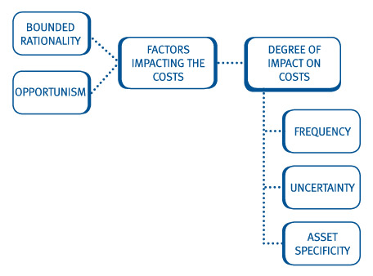
Transaction Cost Economics
to do more with less of public resources
better resources allocation
transaction costs and opportunity costs
http://kfknowledgebank.kaplan.co.uk/KFKB/Wiki%20Pages/Transaction%20cost%20theory.aspx

Slide 31
Principal–Agent Theory - „agencification”
Yamamoto (2003)
organisations in which the implemention function is separated from the policy-making function;
agencificaton means the separation of the provider and user of public services;
new roles:
principal - requires services or goods
principal pays for services
agent – supplies the services or goods;
agent – expected to be well prepared (skilled/trained/experienced) to provide services better and cheaper than the principal by himself;
contract – as a formal basis of relations between principal and agent(s);

Slide 32
Microeconomic Theory
interaction of producers and consumers in the marketplace;
providers and users of social services operate on the quasi-market;
markets (quasi-markets/local markets/internal markets) may be periodic competition;
the pressure on service providers e.g. school authorities – they must respond to the demands of the users ; e.g. parents of school children or school governing boards;
neo-liberaltation – focused on efficiency, individual benefits and remuneration;
neo-liberal orientation ignores the internal processes of the organization, government regulations, social norms to protect from market disadvantages;

Slide 33
The New Economic Sociology
concept of social relations between service providers and users, agents and principals;
mutual trust;
the identification of common values, leading to a few well-established service providers (exlusion of others possible);

Slide 34
NPM characteristic:
market-oriented and use of marekt mechanisms;
application of business management theories and practices,
decentralization of public tasks,
contracting for goods and services,
accountability achived through the measurement of outcomes rather than accounting for inputs,
the measures performance instead of tight control (based on the established rules and regulations),
client/customer/consumer ,
creation of local markets (to provide competitiveness),
new role of public sector – „to seer rather than row”

Slide 35
decentralised control through a variety of service delivery mechanisms (e.g. quasi-markets with public and private service providers competition);
privatization and commercialization;
cutting costs and maximization of utility;
resources allocation - results must justify the expenses;
decentralisation/devolution;
competition created by quasi-markets (local markets of public services) – to improve the quality of services customer driven and reduce/rationalize the costs;
performance specification – contracts, regulations, provisions;

Slide 36
NPM and education policy (S. Tolofari):
managerialism in education;
introduction of school governing boards as in private sector;
transfer to schools from the local authority of powers over budget, appointments, personnel and planning;
shared power (head teacher, teachers, parents, governors and the neighbouring community);
competition for pupils;

Slide 37
public accountability - main goal of education institution;
quasi-market creation (to create competition);
schools more enterpreneurial – to raise the funds;
changed role and relationship with school environment;
competition meant: schools need to attract students;
changed vaules of schooling;
new role of principal (head teacher) – manager;

Slide 38
3. Good governance:
What is good governance?
the processes for making and implementing decisions;
the best possible process for making decisions as good as possible;
The main elements of GG are:
consultation of policies and practices;
following procedures;
providing good quality of public services;
clear roles;
relationships (good working environment);

Slide 39
Source: http://www.rcc.int/pages/70/good-governance

Slide 40
Profits of good government:
promotion of community confidence;
encourage public authorities to better confidence;
leades to better decisions (even public authorities do not agree with them);
helps local authorities to meet responsibilities (legistative);
helps in ethical decision-making process;
Source: http://www.goodgovernance.org.au/about-good-governance/why-is-good-governance-important/

Slide 41
Good governance in education includes:
promotions of effective delivery of education services;
long strategic commitement, goals and planning;
requires involvement of partents, local community and others;
pooling of resources;
excellent communication
transparency
common trust
existence of (social) networks
multi-stakeholders partnerships

Slide 42
Evolution of leadership in public sector:
Traditional leadership:
in the 80s and 90s’;
hierarchical relationship - leaders and followers;
typical for highly structured formal organizations;
followers not treated as part of the process of leadership;
leadership understood as a process of taking challenges and making the right choices by leaders (W. Bennis, B. Nanus);
„conventional wisdom" focused on particular goals and individual ambitions of leaders (R. Heifetz, A. Sinder)

Slide 43
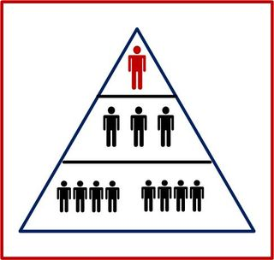
general approach to leadership understood as a one-man game with a strong, dominant personality focused on individual actions;
position of leader did not depend on followers (their presence, attitude, behaviour);
Source: http://edbrenegar.typepad.com/leading_questions/choices/

Slide 44
2. Transformational leadership
Source: http://betterbusinesslearning.com/transform-leader/#.U7eM_5RESgY

Slide 45
late 80s’ (idea from mid 70s’ – J.M. Burns);
relation leader – supporters (followers????) is a source of motivation, mobilization and ethical conduct;
basis for charismatic leadership (values, influence);
values focused on social dimenstion;
new role of leader:
supposed to help marginalized groups;
generate positive relationships in the community (local development)

Slide 46
effectiveness of leadership comes from its „bottom-up” character;
leader’s actions initated by members of the community members (problematic groups);
leader must be open to changes;
be able to motivate supporters,
be able to create a new situation and expectations;
the leader in transformational approach was seen as an adaptive leader

Slide 47
3. Network leadership
Source: http://www.gregoryshea.com/

Slide 48
fits with the approach of good governance in the public sphere;
promoted by the institutions of the European Union (concept of the Community-Led Local Development);
large number of actors involved in the processes of leadership (both - leaders and followers);
dispersal of tasks and decision-making centers;
the bottom-up nature of the initiatives;
more focused on the relationships and the collective nature of the processes, not the same sources of leadership;

Slide 49
Good governance and leadership:
the role of formal leaders is less important in decision-making process!!!!
leader can be: public authority representative, member of NGO, local enterpreneur, initative group, local partnership (collective leader);

Slide 50
Models of leadership in public sector
From traditional to collaborative/network leadership
 | Traditional leadership | Collaborative leadership
power | - one of singular authority -authority hierarchy power based on longevity with a secondary look at prior results | - greater in a collective team -solutions develop from the best ideas of the group to the best solving roblem;
information | -maintaining ownership of information -information means power -limited information allows to maintain authority and control | -wide information sharing -common projects require sharing information -information connected with education
creation of ideas | -decisions usually come from the top levels of institution | - everyone has an opportunity to share ideas
problem solving | -decisions and solutions usually make by the top level | -solutions are brainstormed and discussed with the top level staff

Slide 51
 | Traditional leadership | Collaborative leadership
resources | -provided if necessary or/after decision of approving body -dealing with challenges with limited resources | - trust makes hat resources may be delivered in advance -resources easily allocated depending on the situation and needs
rules and responsibilities | - series of rules, regulations and a hierarchy - can stifle the creative process - can isolate leaders | - information, resources, knowledge, time and effort are shared - roles and responsibilities might evolve and fluctuate
resolving issues | often dealt with on an individual basis leaders fighting fires instead of implementing the preventing changes; | more responsibility for work for team members look for the roots of conflicts and solutions
performance and feedback | review process based on rules morale/ethos of the staff | team members are equally valued work closely together on a daily basis opportunity for immediate feedback, praise and constructive criticism collaborative gives the opportunity to share knowledge and educate members
Source: Perspective on innovations, http://www.innocentive.com/blog/2013/11/21/8-differences-between-traditional-and-collaborative-leaders/ (30.06.2014).

Slide 52
Source: http://www.zoomcollaborate.com/services/skills-training/collaborative-leadership

Slide 53
School director
Leader? Manager? Administrator?
Polish experiences
Requirements for school director postion:
- Art. 36a § 3 of the Act on the education system (September 7th, 1991);
competition;
decision of the selection committee (local authority, school authority, pedagogical supervisor, school board, parent board, representative trade union organizations – teachers’ union);
announcement and selecion process is organized by local authority (mayor);

Slide 54
2 stages of selection process
1st - formal assessment report
2nd – evaluation of candidate
voting (secret ballot);
- since 2012 – school directors can be:
teacher
non-teacher

Slide 55
OECD recommendations for better school leadership:
(Re)definition of school leadership and leaders responsibilities
clearly specified and delimited;
focused on:
improving pedagogical skills of teachers;
implement learning-centred leadership;
effective learning leadership;
new role – to encourage teachers to professional learning, built environment and trust, teamwork,
provide school leaders – autonomy, time and resources;

Slide 56
Encourage the distribution of school leadership
distribution of school leadership can help schools meet the challenges they face;
distributed leadership does not diminish the role of school principals and senior management;
learning leadership of principals is fundamental;
leadership can be distributed in formal or informal way (creation of „ad hoc” groups based on expertise and specific needs);

Slide 57
Develop the knowledge and skills of school leaders
specific skills are needed to fulfil expanding and demanding roles and responsibilities of school leaders;
widespread educator learning;
training opportunities
strategies of professional development
leadership development as a continuum available at different stages of the career;
building networks
base of knowledge

Slide 58
Make school leadership a more attractive profession
succession planning, salary structures and career development opportunities are needed to recruit and trained effective school leaders;
use varied recruitment tools to assess a wider range of knowledge, skills and competences;
succession planning (training programmes for aspiring future school leaders)
need to compare school leaders' salaries with alternative employment possibilities;
career development prospects (e.g. renewable fix-term contract toavid burn out of leaders)

Slide 59
Support school leaders in low performing disadvantaged schools
not always adequately selected, trained and supported;
to strengthen school leaders’ capacity;
to provide general expertise and specialised knowledge to handle the challenges of these schools to school leadership preparation programmes;
to develop coaching, mentoring and networks;
the dissemination of good practices across the systems;

Slide 60
Prepare school leaders for working in diverse schools
create inclusive school and classroom;
focus on developing the competencies of all students;
adequate initial preparation and in-service training;
systematically integrate diversity issues into the curriculum;
review existing training policies to ensure that they address the needs of immigrant students;
monitor how teacher and school leader education for diversity translates into practice;
promote awareness for working in diverse educational contexts;

Slide 61
Source: https://www.keepcalm-o-matic.co.uk/p/keep-calm-and-study-public-policy/

Slide 62
Contact:
anna_kolomycew@o2.pl
anna.kolomycew@ur.edu.pl
FB: Anna Kolomycew

Slide 63
References:
Bass B.M., Riggio R.E., Transformational Leadership, New Jersey 2006.
Bennis W., Nanus, B., Leaders: Strategies for taking charge, New York, 1985.
Burns J.M., Leadership, New York 1978.
Crosby B.C., Byson J.M., Stone M.M., Leading acrossfrontiers: how visionary leaders integrate people, processes, structures and resources, [in:] The new public governance.Emerging perspectives on the theory and practice of public governance, edited bySP Osbrne, London & New York 2010.
Egeberg M. 2003. How Bureaucratic Structure Matters: An Organizational Perspective‘ in G. Peters and J. Pierre (eds) Handbook of Public Administration, Sage, London.
Grill R., Theory and practive of Leadership, London 2006.
Heifetz R.A, Sinder R.M., Political Leadership: Managing the Public's Problem Solving, [in:] The Power of Public Ideas, edited byRB Reich, London 1988.
Local development driven by the community cohesion policy for 2014-2020, European Commission 2011, http://ec.europa.eu/regional_policy/sources/docgener/informat/2014/community_pl.pdf [30.05. 2014].

Slide 64
Mullard M. 2005, (ed) Policy making in Britan: an introduction, Routledge, New York.
OECD/Specialists Schools and Academies Trust: Improving School Leadership, Volume 2: Case Studies on System Leadership, OECD Publishing., 2008.
OECD: Closing the Gap for Immigrant Students: Policies, Practice and Performance, OECD Reviews of Migrant Education, OECD Publishing., 2010.
OECD: Educating Teachers for Diversity: Meeting the Challenge, Educational Research and Innovation, OECD Publishing., 2010.
OECD: Leadership for 21st Century Learning, Educational Research and Innovation, OECD Publishing., 2013.
Painter M., Peters G.B. 2010, (eds) Tradition and Public Administration, Palgrave Macmillan, New York.
Peters G.B., 2003, The Changing Nature of Public Administration: From Easy Answers to Hard Questions, „ VIEŠOJI POLITIKA IR ADMINISTRAVIMAS” no. 5/2003.
Pont, B., D. Nusche and H. Moorman: Improving School Leadership, Volume 1: Policy and Practice, OECD Publishing., 2008.
Rost J.C., Leadership for the twenty-first century, Westport, 1993.

Slide 65
Schleicher , A.(ed.): Preparing Teachers and Developing School Leaders for the 21st Century: Lessons from around the World, OECD Publishing., 2012.
Tolofari S., New Public Management and Education, Policy Futures in Education, Volume 3, Number 1, 2005.
Yamamoto K., 2004, Agencification in Japan: renaming the revolution?, in Pollitt Ch., Talbot C. (eds) Unbundled government. A critical analysis of the global trend to agencies, quangos and contractualization, Routledge, New York.

