Slide 1
“Educating Leaders – Initial and continuing teachers’ education, professional development of leaders.”
‘LEARNING FOR LEADERSHIP IN EDUCATION’
2014 ERASMUS INTENSIVE PROGRAMME
University of Peloponnese, Korinthos, Greece; 8th July 2014.
Presented by: Caroline Lynch and Pamela Skerritt,
M.Sc. in Education and Training Management (Leadership),
Dublin City University, Ireland.
Notes:
Good afternoon and welcome to our presentation on Educating Leaders in the Irish Education system
I am Caroline Lynch and this is my colleague Pamela Skerritt
We would like to start by telling you all a little about our journey to leadership studies and why we are standing here today

Slide 2
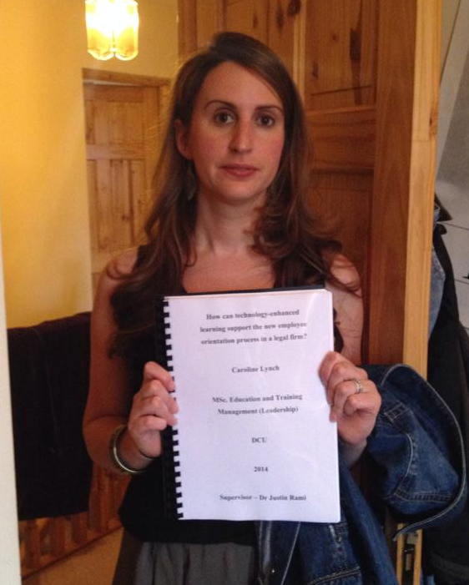
Caroline Lynch
Notes:
I completed my secondary school studies and gained my Leaving Certificate in 1996
Like many Irish school leavers I immediately entered third level education and began studying for a degree in sociology and social policy
However I was unprepared for college life, disinterested in my studies and decided to leave full time education and seek employment.
I was fortunate to gain employment in a legal firm through a family connection and have worked there in various departments for the past 17 years. I am now the Information and Communications Technology Training Manger in the organisation.
I submitted my Masters thesis on 27 June 2014. This thesis explored how new employee learning and development could be supported using technology.

Slide 3
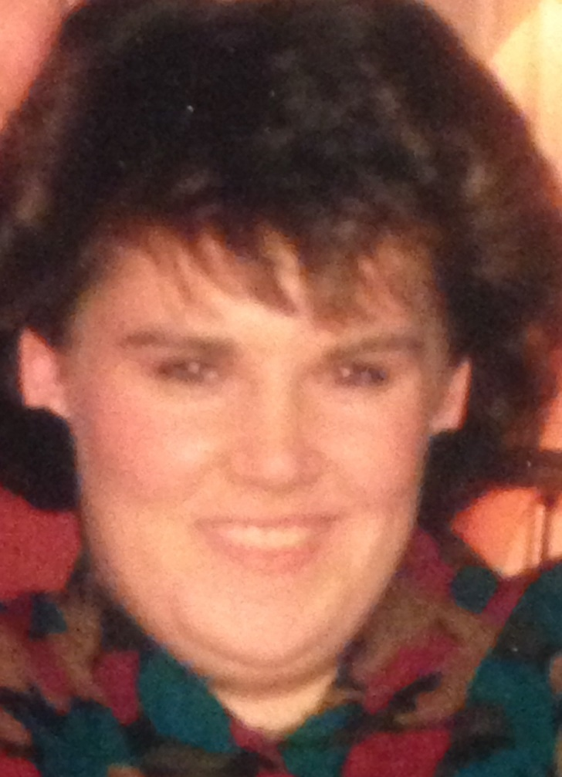
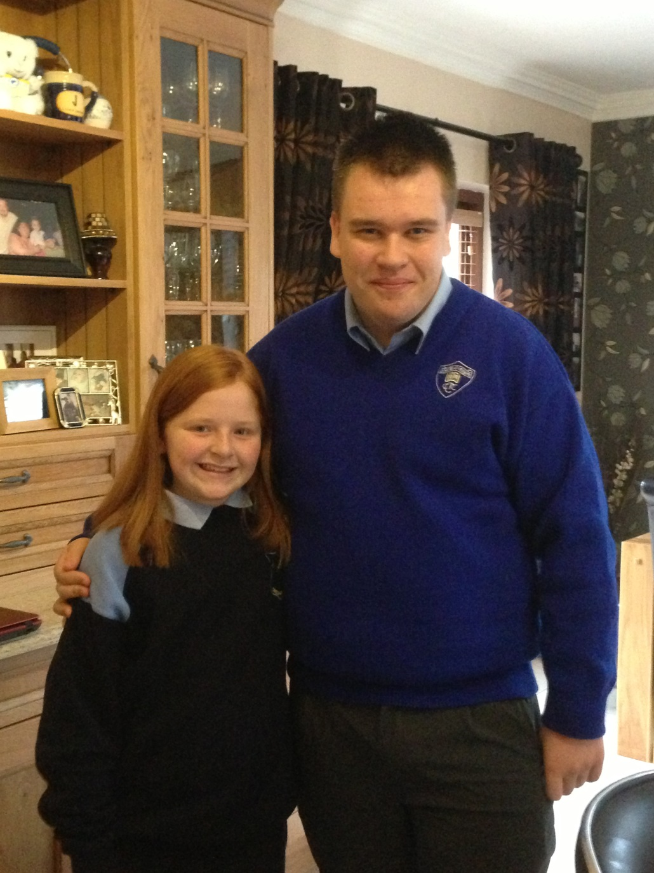
Pam Skerritt
Notes:
I left school in 1988 and transferred immediately to a nursing program run by the order that I attended secondary school with. After qualifying in 1991, became disillusioned with nursing and undertook my second educational program, 3 years in Montessori Education to include special needs.
In 1998 undertook diploma in UCD Level 7 certificate in Health and safety and then Level 8 diploma in occupational health and safety

Slide 4
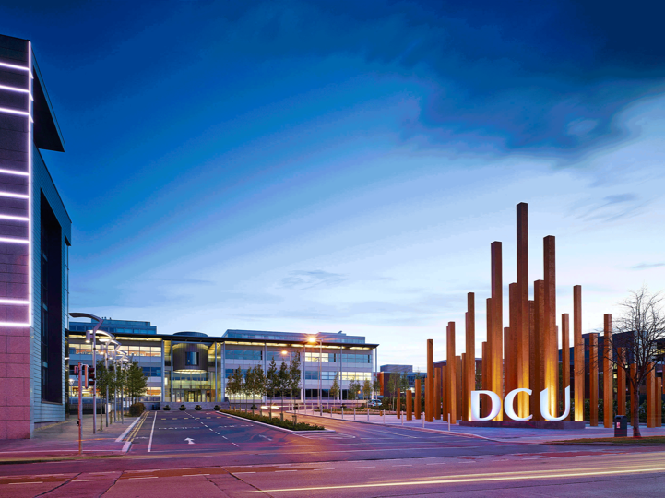
Notes:
Our paths have crossed in DCU
We have both completed the part time BSc in Education and Training
Caroline – graduated 2009
Pamela – graduated 2013
We have both moved on to study leadership in education – both undertaking the MSc in Education and Training Leadership (Management)

Slide 5
This Session
Education and training as a profession in Ireland
Teacher education in Early Childhood Care & Education sector
Teacher education in Primary & Secondary Levels
Teaching in Work, Community and Vocational Education
Teaching in Higher Education
Leadership Development
Notes:
In this session we will discuss
Education and training as a profession in Ireland
Teacher education in Early Childhood Care & Education sector
Teacher education in Primary & Secondary Levels
Teaching in Work, Community and Vocational Education
Teaching in Higher Education
Leadership Development

Slide 6
….since last Tuesday….
What you need to know about Irish education system…
Notes:
To follow on from Michael and Siobhans points last week regarding what you need to know about the Irish education system – one further point…..

Slide 7
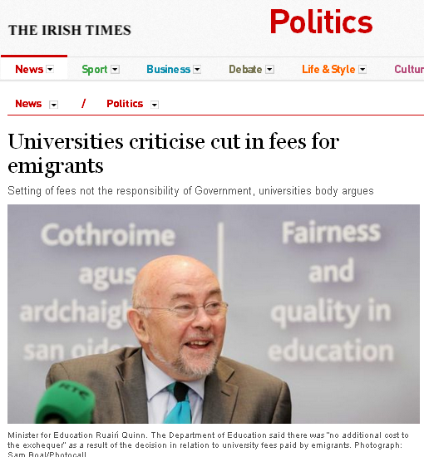
Notes:
Our Education Minister resigned last week due to appointment of new party leader
What does this mean?
Minister had a revolutionary attitude toward education – promoting non religious interference within Irish education systems
Has overseen a period of great change in area of curriculum design, assessment and evaluation – formation of QQI, new Junior cycle
Adopted a holistic approach to education and training - arguing that critical thinking and life-skills need to be developed from an early stage
Junior cycle seen by most as positive change but viewed negatively by unions and teachers have been informed not to implement it
Unions have a significant influence on the practice of our primary and secondary school teachers – let’s watch this video
It will be interesting to see how the next minister for ed deals with union and teacher resistance to new Junior cycle

Slide 8
Education and training as a profession in Ireland
Notes:
We will now discuss education and training as a profession in Ireland and what impact the recession has had on the status of education in Ireland

Slide 9
Education in Ireland
a central pillar in the economic, social and cultural development of Irish society
Notes:
As you will know from Michael and Siobhan's presentation last week - Education in Ireland a central pillar in the economic, social and cultural development of Irish society
Governments and social partners view education as strategically interlinked with national planning
Unlike the UK context – education policy is less influenced by changes in government – education policy controlled by department of education – and our main political parties are not so ideologically different
So change in Minister for Ed shouldn’t have major impact on policy

Slide 10
Teaching Profession
High social status
Keen competitiveness for entry into all levels of teaching
Among the most competitive teacher preparation selection systems in Europe
In 2008 - 2455 applicants for 800 places on postgraduate teacher education courses
Notes:
The teaching profession in Ireland enjoys a high social status – SHOW VIDEO
There is keen competitiveness for entry into all levels of teaching
Ireland has one of the most competitive teacher preparation selection systems in Europe
For example in 2008 - 2455 applicants for 800 places on postgraduate teacher education courses in the four National University Education departments, where approximately 70% of secondary school teachers pursue their teaching qualification

Slide 11
Post Great Recession?
Demand for places remains high despite the unlikely prospect of qualified teachers securing a permanent post
2006 - 1249 students graduated from postgraduate teacher education courses
Only 4.9% secured permanent teaching posts
62.7% - employed in temporary and part-time positions
Between 2007- 2012 - 12% increase in the number of Education graduates
Notes:
Demand for places in teacher education remains high despite the unlikely prospect of candidates securing a permanent post once qualified.
In 2006 - 1249 students graduated from postgraduate teacher education courses.
Of these only 4.9% secured permanent teaching posts
62.7% - of qualified teachers are employed in temporary and part-time positions
However despite this between 2007- 2012 12% increase in the number of Education graduates

Slide 12
Education System
Pre-Primary
3-5 years
Mainly private settings
ECCE funding – free pre school year
Non compulsory
Primary
5-12 years
State funded
No fees (but other costs)
Compulsory
Junior Cycle
(Secondary)
13-16 years
State examined
No fees (but other costs)
Compulsory
Senior Cycle
(Secondary)
16-18 years
2-3 year cycle
Optional Transition year – experience based
Non-compulsory
Third Level
18+
Vocational training
Youthreach
VTOS
ETB’s
Colleges
Universities
Notes:
So just a short recap of our national education system

Slide 13
Central Applications Office
processes applications for undergraduate courses in Irish Higher Education Institutions (HEIs).
Decisions on admissions are made by the HEIs who instruct CAO to make offers to successful candidates
Admissions typically based on grades acquired in Leaving Certificate
Notes:
CAO processes applications for undergraduate courses in Irish Higher Education Institutions (HEIs).
Decisions on admissions are made by the HEIs who instruct CAO to make offers to successful candidates
Admissions typically based on grades acquired in Leaving Certificate
Principles of simplicity, equity, transparency, differentiation and granularity (candidates achievements)

Slide 14
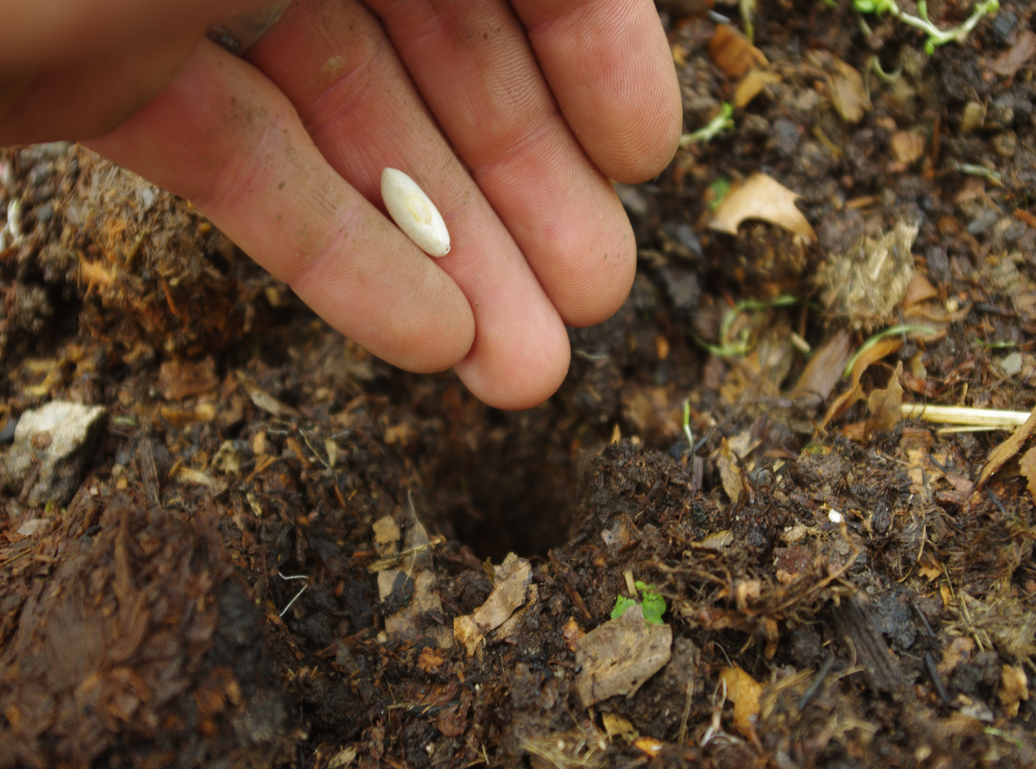
Early Childhood Care and Education (ECCE)
Notes:
We will now explore teacher and leader education and development in the Early Childhood care and education sector - ECCE

Slide 15
Provision
No long tradition of children attending pre-school services
Delivered outside formal education system
Private, community and voluntary organisations
No set structure for pre school in Ireland
Notes:
No long tradition of children attending pre-school services
Delivered outside formal education system
Private, community and voluntary organisations including crèches, nurseries, pre-schools, naionrai,( Irish language pre-schools), playgroups, day-care, Montessori
Provision is overseen by our health service executive HSE and each council region has it’s own pre school officer whose primary remit is to look at facilities, qualifications of staff and care with little influence on curriculum
No set structure for pre school in Ireland

Slide 16
Workforce Development Plan 2010
“ while diverse in terms of philosophies, practice and qualification, there is a high degree of consensus around the qualifications profile required for the workforce”
To ensure those involved in providing early childhood care are “appropriately qualified for their role and responsibilities”
Notes:
The Workforce development plan for the ECCE sector drafted in 2010 recognises that
“ while (the ECCE) sector is diverse in terms of philosophies, practice and qualification, there is a high degree of consensus around the qualifications profile required for the workforce”
Key objective of this plan is to ensure that those involved in providing early childhood care are “appropriately qualified for their role and responsibilities”
It also identifies career paths and progression routes for those who choose this area of work and provides clarity regarding the core skills and knowledge essential to practice effectively in an ECCE setting.

Slide 17
Recruitment
Each organisation has own procedures
2006 Child Care (Pre-School Services) Regulations – each organisation must have management, recruitment and training policies in place
No requirement to be qualified – teachers must be “suitable and competent adults”
Must undergo vetting by Irish police
Notes:
Each organisation in this sector has its own recruitment procedures
However according to the 2006 Child Care (Pre-School Services) Regulations – each organisation must have management, recruitment and training policies in place
No requirement to be qualified – teachers must be “suitable and competent adults”
Employees must undergo vetting by Irish police
This is enforced through our Childrens First document – amended in 2013

Slide 18
Leaders in ECCE settings
Those who participate in free Pre-School year scheme must have qualification in childcare/early education at Level 6 on NFQ
i.e. Supervision in Childcare
Higher funding levels if all staff have level 5 and if leader has level 7 (degree)
Notes:
Leaders in organisations that participate in the free-school year scheme must have a qualification in ECCE at Level 6 on our National Framework of Qualifications (higher certificate)
An example of this qualification would be the Supervision in Childcare Award (offered by private providers or ETB’s
This course includes 8 modules and covers areas like child development, human growth and development, health and safety. With optional modules in Special Needs Education or Intellectual disabilities
Participants must also demonstrate work experience
The certifying body for this award is QQI – Quality and Qualifications Ireland, – formerly FETAC
Organisations in this sector also enjoy higher funding levels if all staff have level 5 qualifications (Leaving Certificate) and the organisations leader has a Level 7 qualification - degree

Slide 19
Education and Training
Wide range of education and training options available in the ECCE sector from levels 1-10 on NFQ
Levels 1-6 offered by private colleges, QQI registered organisations or colleges of further education
Programs at levels 6-10 typically full time, run by universities and institutes of technology
Notes:
Wide range of education and training options available in the ECCE sector from levels 1-10
Levels 1-6 offered by private colleges, FETAC registered organisations or colleges of further education – these include flexible delivery methods – some are accredited, some are not
Programs at levels 6-10 typically full time run by universities and institutes of technology
However this can make it difficult for those already working in sector to access further education opportunities without leaving workforce

Slide 20
Recognition of Prior Learning
Workforce Development Plan recommends that providers build recognition for prior learning into course design and use for entry and exemptions into courses in ECCE sector
Challenging – given the absence of regulations on qualifications in the area
Notes:
Workforce Development Plan recommends that providers build recognition for prior learning into course design and use for entry and exemptions into courses in ECCE sector
Challenging – given the absence of regulations on qualifications in the area

Slide 21
Primary and Secondary Teacher Education
Notes:
Pam

Slide 22
Notes:
Overseeing body for Primary and Secondary teaching qualifications is Department of Education and Skills
Once you have a degree you can progress at any stage – however we will outline the most common paths into Primary and Secondary teacher Education

Slide 23
The Department of Education will formulate, in active co-operation with the partners in education, a strategic framework for the in-career professional development of teachers with explicit, achievable objectives, it specified that a target of 15 groups and criteria for evaluating the impact of in-career development programmes…
A well-developed and carefully managed induction programme coinciding with the teacher’s probationary year, will be introduced for first – and second-level teachers.
White Paper: Charting Our Education Future, - April 1995
Notes:
The Department of Education will formulate, in active co-operation with the partners in education, a strategic framework for the in-career professional development of teachers with explicit, achievable objectives, it specified that a target of 15 groups and criteria for evaluating the impact of in-career development programmes…
A well-developed and carefully managed induction programme coinciding with the teacher’s probationary year, will be introduced for first – and second-level teachers.
White Paper: Charting Our Education Future, - April 1995
Recent changes implemented include – Training for teachers has been lengthened from three to four years at undergraduate level and from one to two years at post-graduate level with an increased focus on pedagogy.

Slide 24
Entry into the profession
Two routes – post secondary or post graduate
High grades required in Leaving Certificate exam for those intending to follow concurrent courses for both primary and secondary teacher education courses
90% of entrants to various postgraduate teacher preparation programmes hold honours degrees.
Teacher training provided by universities
Notes:
Two routes – post secondary or post graduate (high numbers of mature students)
High grades required in Leaving Certificate exam for those intending to follow concurrent courses for both primary and secondary teacher education courses
Applicants for entry to primary teaching tend to come from the top quartile of the achieving students in the school Leaving Certificate Examination, and
those taking the course for graduates are also of a high calibre. 90% of entrants to various postgraduate teacher preparation programmes hold honours degrees.
Accordingly, to date the government has not had to engage in any special measures to stimulate recruitment for the teaching career.

Slide 25
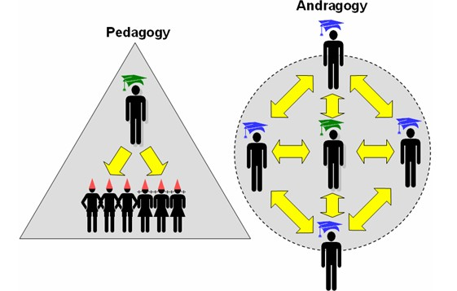
Pedagogy Andragogy
http://leanlearning.files.wordpress.com/2008/08/pedagogy-andragogy.jpg
Notes:
Secondary school – dialectic teaching
However when students move into degree program emphasis is on self directed learning with support from leading tutors or lecturers
Challenge for those pursuing teaching as a profession
It is assumed that they can automatically become a self directed learner

Slide 26
Primary Teacher Education
Points Systems based on Final Examination (Leaving Certificate – Second Cycle)
Application to CAO
4 year degree
One curriculum subject – Irish, Maths, English
Teaching practice – 2-4 weeks per year
Notes:
Primary and secondary teacher education process very similar
4 year degree
One curriculum subject – Irish, Maths, English
Teacher training methods for all subjects is similar
Teaching practice – 2-4 weeks per year
Must have honour grade in Leaving Cert – Irish – or prove fluency
Usually BEd and Irish or Maths etc

Slide 27
Secondary Teacher Education
Points Systems based on Final Examination (Leaving Certificate – Second Cycle)
Application to CAO
4 year degree program including a curriculum subject
Notes:
Entry to Secdonary teaching
Points Systems based on Final Examination (Leaving Certificate – Second Cycle)
Application to CAO (Central …. ) organisation
No interview required
Secondary Education – 4 year degree program including a curriculum subject i.e Physical Education and English or History or Maths.
All the teaching modules – degree and postgrad combined
100 hours teaching practice over 4 years

Slide 28
Postgraduate Entry
Professional Diploma in Education (PDE)
1 year full time or 2 year part time
Primary degree in related field – 2.2 or higher
Teaching experience can be used to meet entry requirements
4 inspections conducted by member of university staff
Notes:
Professional Diploma in Education (PDE)
1 year full time or 2 year part time
Primary degree in related field – 2.2 or higher
Teaching experience can be used to meet entry requirements
Course includes teaching practice - must complete 100 hours teaching (minimum class 15 students) in mainstream secondary school
4 inspections conducted by member of university staff

Slide 29
Sample Modules
History
Sociology
Philosophy
Psychology
Teaching Methods
Optional Modules
Notes:
Modules Taught on both degree and postgraduate programs:
History
Sociology
Philosophy
Psychology
Teaching Methods (relevant to subjects)
Optional Modules
Special Needs Education
Drama or the Arts
Integration of Languages – emphasis on students who don’t have English as First Language
Curriculum Development

Slide 30
Supervision & Assessment of Placements
Continuous Assessment of theoretical content
Work placements within a school environment
Lesson planning is key part of process
Pre planned monitoring takes place
http://sd.keepcalm-o-matic.co.uk/i/keep-calm-and-pretend-it-s-on-the-lesson-plan-47.png
Notes:
While on placement
6 – 8 week per year – approx. 18 weeks total
Placements are pre-planned, pre-structured and monitored by inspectors, learners are aware of inspectors arrival
College tutor organises with learner what school they will go to, what lessons will be delivered (to help them improve teaching skills) – teach individual lessons during the day – rather than spending all day teaching
Lesson planning is key part of this process – must demonstrate to inspector that they can competently plan lessons

Slide 31
Post Qualification
Conditional registration with Teaching Council – PQC
300 hours working with people studying at relevant level
100 hours must be teaching hours
Rest can include supervision, sports, school trips etc.
School principal – certifies this
Notes:
Conditional registration with Teaching Council – PQC
300 hours working with people studying at relevant level
100 hours must be teaching hours
Rest can include supervision, sports, school trips etc.
School principal – certifies this

Slide 32
http://www.mnn.com/sites/default/files/styles/featured_blog/public/teacher_6.jpg
Graphic of Teacher
Degree
300 hours teaching practice
Post qualification competency
Fully qualified teacher
✓
✓
✓
✓
Notes:
Once you have completed your degree, gained your 300 teaching practice you are awarded your Post Qualification Competency and are now a fully qualified teacher.
However those 300 hours must be completed within 3 years of completing degree/postgrad, given the scarcity of available teaching positions in the current economic climate, acquiring these hours in this time frame can prove difficult.

Slide 33
Continuous Professional Development (CPD)
Induction program
Yearly registration with Teaching Council – €90 fee
In-service days
Mentoring
Notes:
Induction program
All teachers must register annually with the teaching council
In service training each year 5-6 days
Covers range of skills including IT skills, communications, personal development with little or no emphasis on leadership
In-service days often used for holidays no obligation to use them for training or further development

Slide 34
The National Induction Program for Teachers
Notes:
A national induction program for teachers been introduced in recent years
This program of teacher education usually takes place in first year after qualifying.
The aims of the program are to develop a culture of lifelong learning and the program offers professional and personal support to the newly qualified teacher.
The program consists of online and school based support, workshops, professional support groups and school visits

Slide 35
Work, Community and Vocational Training

Slide 36
Applicants to these areas
Early school leavers 16+
Those that fail to meet minimum points requirements
Vocational based – electricians, plumbers
People returning to education
Unemployed
Migrants
Notes:
Early school leavers 16+
Those that fail to meet minimum points requirements
Vocational based – electricians, plumbers
People returning to education
Unemployed
Migrants

Slide 37
Who delivers training?
Experts in fields
Business people
Artists or crafts people
Community leaders
Notes:
Experts in fields
Business people
Artists or crafts people
Community leaders

Slide 38
Providers in this area
SOLAS (formerly FAS)
ETB (Education and Training Boards)
Department of Social Protection
Momentum
Jobspath
Private Training Colleges and recognised institutions
Notes:
Delivered in ETB’s SOLAS private registered organisations within QQI – all are regulated and must map courses to national framework of qualifications – including learning outcomes, assessment tools. Internally and externally authenticated. For fair and consistent assessment of learners and transparency.
All training must be delivered under a QA – quality Assurance document.

Slide 39
Notes:
Draw frame around levels 1-6

Slide 40
http://myflexiblepencil.com/wp-content/uploads/2012/04/road_to_heaven_BLOCKED_by_saturn21-400x383.png
Notes:
Learners often don’t get opportunity to move on to university level
But it is possible for transition

Slide 41
Relevant Changes
From April 2013 all those providing training in vocational/community sector must register with Teaching Council
And have necessary qualification
One route is - BSc in Education and Training
Notes:
For vocational sector
Ensues those delivering vocational training have necessary teaching qualifications
Those on full time salaries with ETB had to comply by April 2013 – however those on contracted hours do not have to have this qualification
As of 2012 all teachers within Work and Community sector must register with Teaching Council – previously only Primary and Secondary teachers – huge shift in ensuring better teaching standards and qualifications.

Slide 42
Networking of Agencies
Irish Institute of Training and Development
The Trainers Network
Irish Safety and Health Network
http://itcilo.files.wordpress.com/2011/03/socialnetwork.jpg
Notes:
Irish Institute of Training and Development
The Trainers Network
Irish Safety and Health Network
3 organisations that have come to the fore in support of these changes

Slide 43
Higher Education

Slide 44
Theory
Policy on the Continuum of Teacher Education - 2011
innovation, integration and improvement should underpin all stages of the continuum
Policy taken from Teachers Matter: Attracting, Developing and Retaining Effective Teachers – OECD 2005
Notes:
Policy on the Continuum of Teacher Education – 2011 – published by Teaching Council and heavily influenced by OECD report 2005
This policy states that innovation, integration and improvement should underpin all stages of the education continuum

Slide 45
Educator
Subject Expert
Notes:
No mandatory teaching qualification required for teaching in Irish higher level institutions
Strong Masters degree generally sufficient (with view to embarking on PhD)
Ability to be a subject expert carries more weight than being an educator
Academic staff members in higher education institutions are public servants and are appointed in accordance with general national employment legislation.

Slide 46
National strategy for higher education to 2030
All higher education institutions must ensure that all teaching staff are both qualified and competent in teaching and learning, and should support ongoing development and improvement of skills
Notes:
According to the Department of Education and Skills (2011) National strategy for higher education to 2030
All higher education institutions must ensure that all teaching staff are both qualified and competent in teaching and learning, and should support ongoing development and improvement of skills
However no criteria for what defines qualified or competent. Also note the use of the word should!
The National Strategy recognises that enhancement of the student-learning experience will necessitate system-wide provision of academic professional development (APD) to ensure that teaching staff are not just specialists in their field, but also competent professionals who develop and update their teaching skills throughout their careers.

Slide 47
Continuing Professional Development
Most higher education institutions provide continuing professional development (CPD) for all staff in a range of areas
Not mandatory
Little time or support to undertake such activities
Many involved in continuous research
http://mergerverger.files.wordpress.com/2012/07/merger-verger-falls-off-a-cliff.jpg
Notes:
Most higher education institutions provide continuing professional development (CPD) for all staff in a range of areas. For example the courses offered through Trinity College Dublin’s Staff Development Programme 2011–2012 include report writing, time management, managing conflict, editing and proofreading, personal effectiveness, assertiveness training, minute-taking, project management, supervisory management, and critical thinking
Other options include conferences, masters, PhD and postgraduate studies, online courses, workshops, seminars etc
Over the past decade there have been significant advances in teaching and learning provision in Irish higher education, supported principally through the HEA’s Strategic Innovation Fund (SIF). The establishment of centres for educational development and academic practice, and of virtual learning environments (VLEs) in institutions have supported greater engagement with technology-enhanced learning and other innovative pedagogies.
CPD in the Higher Education sector is not mandatory, although it is often promoted through performance management and appraisal systems. There is often little time or support to undertake such activities. In a recent survey “Voices of Academics in Higher Education: Perspectives on Professional Development” only 27% of respondents regularly participated in structured CPD, with one respondent noting that there was no time and no support for such CPD activities and that early stage academics are thrown off a cliff and told to sink or swim
Many academic staff are involved in continuous research and may apply for sabbatical leave, defined as a form of leave with full or partial salary to undertake research or other appropriate study related to an individual’s academic or professional field.

Slide 48
Postgraduate Qualifications
Number of institutions offer a postgraduate certificate in teaching and learning in higher education
The first postgraduate academic professional development (APD) programme was DIT’s Certificate in Third-Level Learning and Teaching
National Academy for the Enhancement of Teaching & Learning
To raise the value and contribution of excellence in teaching within the Irish higher education sector
Notes:
Number of institutions offer a postgraduate certificate in teaching and learning in higher education
The first postgraduate academic professional development (APD) programme was DIT’s Certificate in Third-Level Learning and Teaching
National Academy for the Enhancement of Teaching & Learning established in 2012
To raise the value and contribution of excellence in teaching within the Irish higher education sector

Slide 49
Guidance Services
Notes:
Guidance services in the educational sector are based in post-primary schools, higher and further education colleges and through adult and second chance education programmes.
Guidance counsellors advise students and young people so that they can make informed choices about their future in relation to employment, education and training. Responsibilities include assessing ability and potential in students, providing one-to-one counselling, and liaising with other professionals in this area.
Guidance and counselling in Ireland is made up of three separate yet interlinked areas. These are:
Personal and Social Guidance and Counselling
Educational Guidance and Counselling
Vocational Guidance and Counselling.
To work in guidance in different educational settings, qualifications vary according to the requirements of the role and the employee. Guidance counsellors working in second level are normally required to hold recognised teaching qualifications.
Guidance counselling studies can also be undertaken after primary degree
Guidance counsellors are especially relevant in Senior Cycle – guidance looked at twice – Transition Year (work placements and project work) and also CAO application

Slide 50
Leadership Development
http://us.123rf.com/450wm/olechowski/olechowski1210/olechowski121000013/15662080-leadership-concept-in-word-tag-cloud-on-white-background.jpg
Notes:
Many avenues to leadership roles
2 examples of programs supporting leadership in education

Slide 51
Route to Principal
5 years teaching experience
Application form questions:
Describe what you believe to be the characteristics of an effective school?
Describe what you believe to be the characteristics of an effective principal ?
What is your personal vision for the role of principal in a school?
What do you regard as the key issues in education and how do these impact on the role of principal?
Interview – approx. 1 hour – includes 45 minute presentation on candidates vision for the school
Interview panel 3-5 persons
Notes:
In Ireland, when one speaks of the leader in the school context it is generally taken to refer to the principal.
The current rhetoric of learning-centred leadership supports and values the experience of teaching as a pre-requisite for the role of the principal as school leader.
5 years teaching experience required to apply to be school principal
Typical application form questions:
Describe what you believe to be the characteristics of an effective school?
Describe what you believe to be the characteristics of an effective principal ?
What is your personal vision for the role of principal in a school?
What do you regard as the key issues in education and how do these impact on the role of principal?
Interview – approx. 1 hour – includes 45 minute presentation on candidates vision for the school
Interview panel 3-5 persons

Slide 52
Professional development for 3,000 school leaders
Provides support to newly appointed principals and deputy principals
Leadership as an inclusive process
Includes face-to-face interactive seminars, active learning networks and virtual learning environments
Notes:
Leadership Development for Schools (LDS) is a programme fun­ded by the Department of Education and Science (DES) for the development of school leaders.
Staffed by experienced school leaders seconded from their positions to the programme.
Provides professional development for 3,000 emerging and established school leaders on an annual basis.
It also provides support to newly appointed principals and deputy principals, to experienced principals with their deputies and to middle management teams.
LDS programmes are rooted in a strong commitment to supporting programme participants in their ongoing development as leaders while focussing on improving outcomes for all pupils in Irish schools.
Aims to promote the concept of leadership as an inclusive process by providing accessible, effective leadership training for participants through a variety of models including face-to-face interactive seminars, active learning networks and virtual learning environments.

Slide 53
MSc in Education & Training Management (Leadership)
Enable students to:
Develop the knowledge and skills to provide effective leadership
Acquire key principles, best practices, characteristics and the organisational strategy required by managers and leaders.
Develop self-management skills to become more effective managers, educators and learning facilitators.
Notes:
This program enable students to:
Develop the knowledge and skills to provide effective leadership
Acquire key principles, best practices, characteristics and the organisational strategy required by managers and leaders.
Develop self-management skills to become more effective managers, educators and learning facilitators.

Slide 54
Introduction to Management Thought and Practice
Leadership and Performance Management
Organisational Decision Making
Research Design
Organisational Behaviour Change
Management of Entrepreneurial Education and Training
Modules
Notes:
Modules include
■ Introduction to Management Thought and Practice
■ Leadership and Performance Management
■ Organisational Decision Making
■ Research Design
■ Organisational Behaviour Change
■ Management of Entrepreneurial Education and Training
Independent Research Project
Brings together leaders and potential leaders from a wide range of educational backgrounds – primary, secondary, higher education, private sector

Slide 55
Discussion questions?
Do you see the Irish teacher education system as fair and equitable?
Watch this video
How do you think teachers should be evaluated?

Slide 56
Stay in touch
Caroline Lynch
Caroline.Lynch53@mail.dcu.ie
Pamela Skerritt
Pamela.Skerritt2@mail.dcu.ie

